Slide 1
HelpCare: An AI Helper Deployed on Azure
Group 5: Soroush, Dhruv

Slide 2
Introduction
https://www.youtube.com/watch?v=fDm1UHT4C8s

Slide 3
LITERATURE REVIEW
AI-Powered Virtual Health Assistants: Transforming Patient Engagement Through Virtual Nursing By Chavali, Durga, Vinod Kumar Dhiman, and Siri Chandana Katari. "AI-Powered Virtual Health Assistants: Transforming Patient Engagement Through Virtual Nursing." Int. J. of Pharm. Sci 2 (2024): 613-624.
AI-Powered Virtual Health Assistants: Transforming Patient Engagement Through Virtual Nursing By Adebis hertiage Samuel Obafemi Awolowo University.

Slide 4
Virtual Health Assistance – AI-Based By Dhruvitkumar Talati
Enhancing Patient Care Through IoT-Enabled Remote Monitoring and AI-Driven Virtual Health Assistants: Implementing Machine Learning Algorithms and Natural Language Processing By Kalusivalingam, Aravind Kumar, et al. "Enhancing Patient Care Through IoT-Enabled Remote Monitoring and AI-Driven Virtual Health Assistants: Implementing Machine Learning Algorithms and Natural Language Processing." International Journal of AI and ML 2.3 (2021).

Slide 5

Project Overview
Django Web App deployed on Azure Cloud
Uses a PostgreSQL database hosted on Azure
Uses an Azure-hosted AI model

Slide 6
Project Link
https://helpcare-egcpaqffcefdaag0.canadacentral-01.azurewebsites.net/

Slide 7
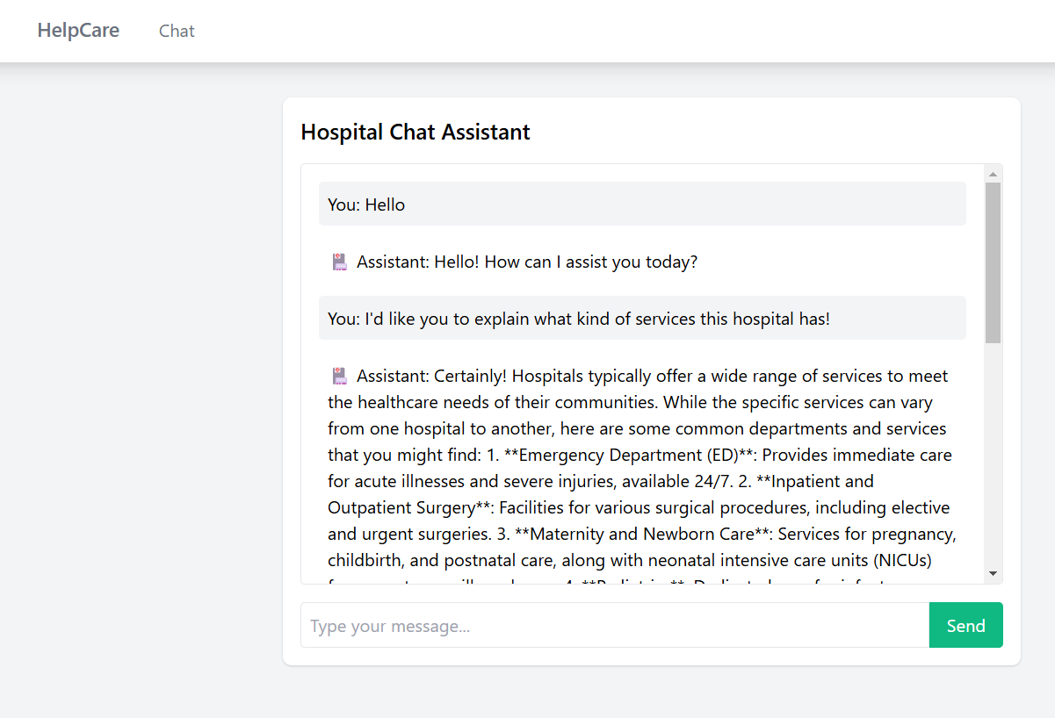
AI output

Slide 8
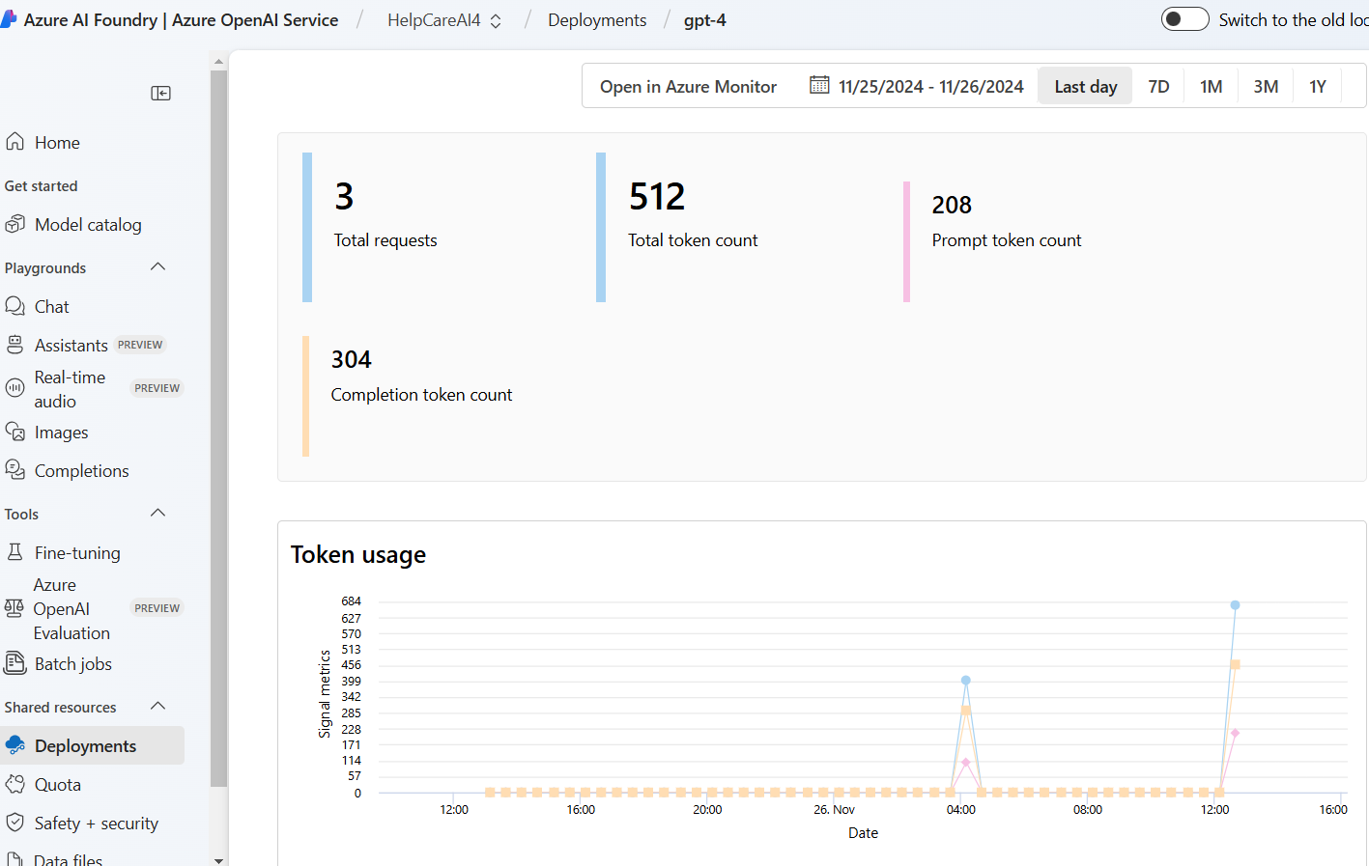
AI output metrics

Slide 9
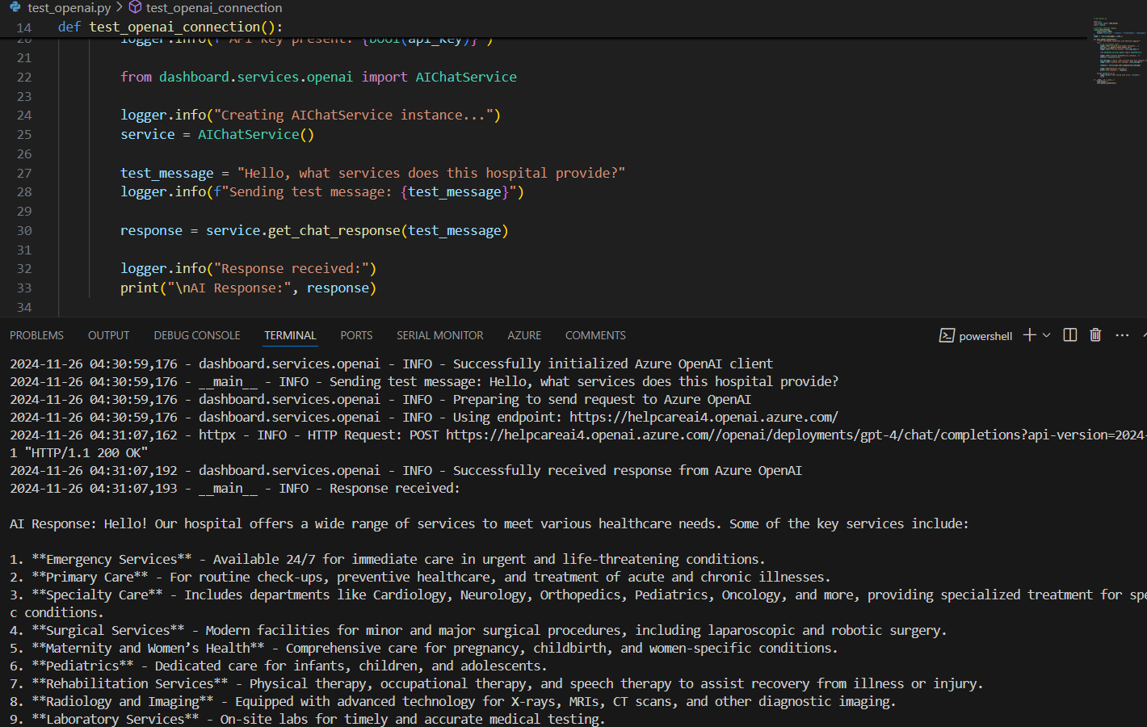
Testing

Slide 10
Technologies Explored
Python
Django
GitHub
GitHub Actions
Jira
Azure App Service
Azure PostgreSQL database
Azure AI Foundry (OpenAI)
Overleaf (Report)

Slide 11
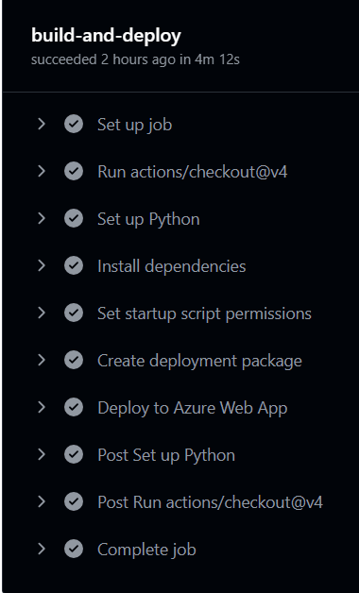
Continuous Deployment
Used GitHub Actions with a .yml file to handle Azure cloud deployment
Deployment carried out every time code was pushed to main branch

Slide 12
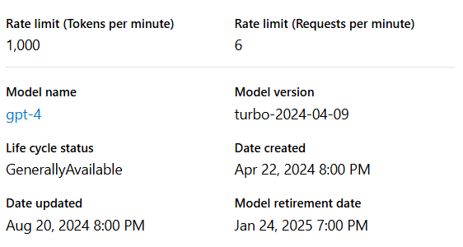
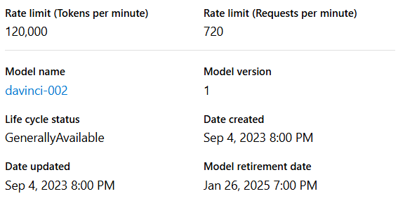
AI Models (Free Tier)

Slide 13
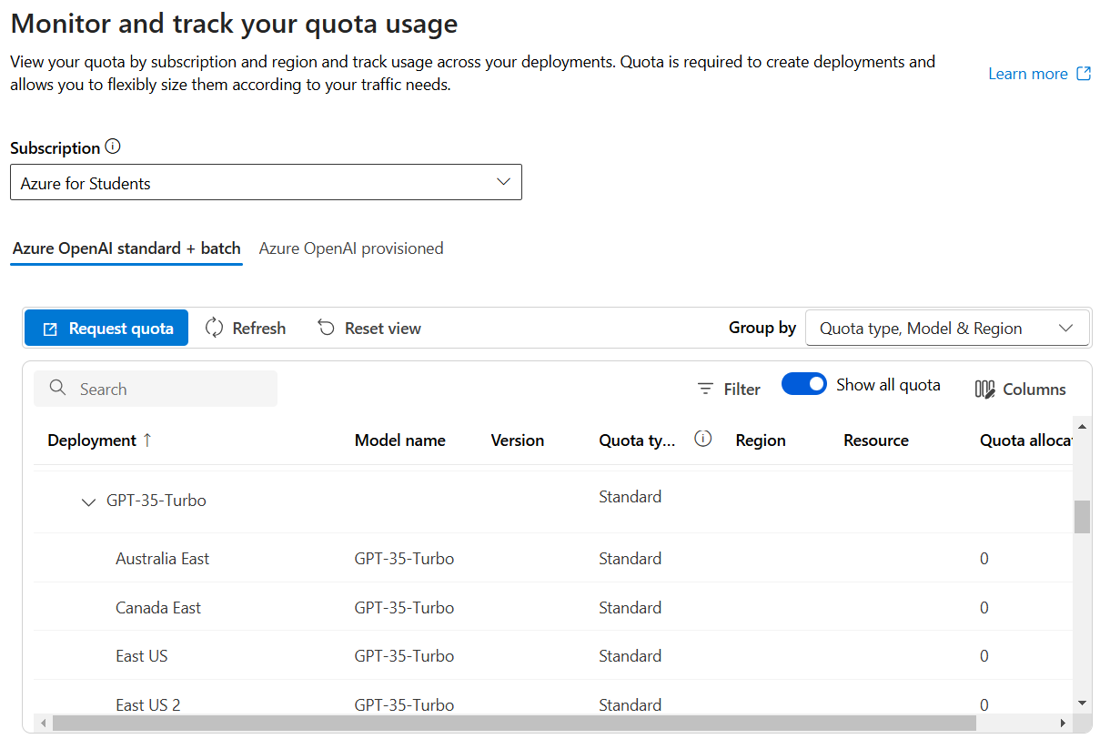
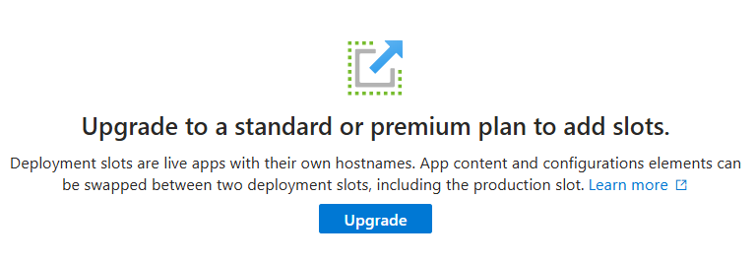
Challenges
Limited services on the free tier
Deployment issues
Unfamiliarity with Cloud Deployment
Switched from Google Cloud to Azure partway through development

Slide 14
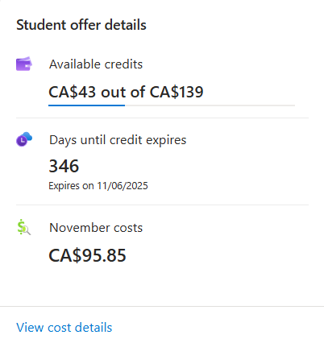
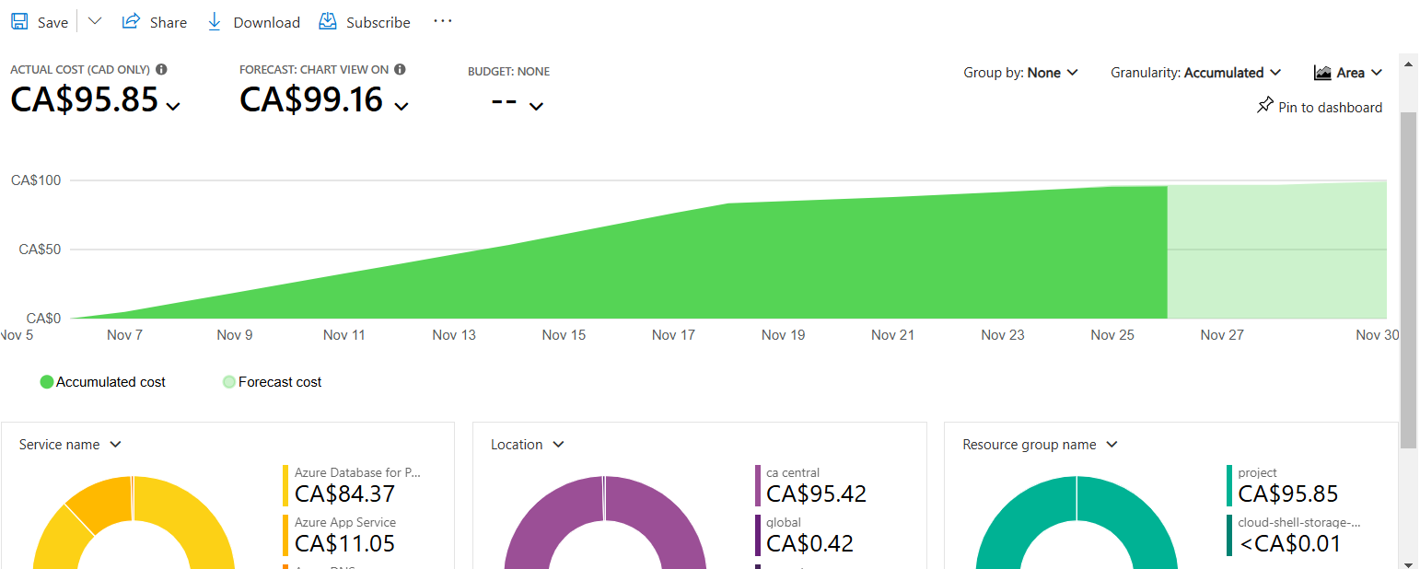
Cost Estimation

Slide 15
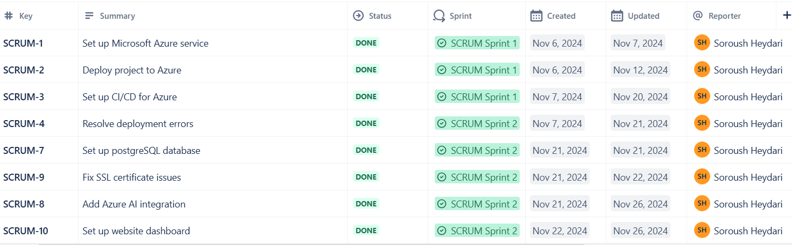
Jira Tasks Timeline

Slide 16
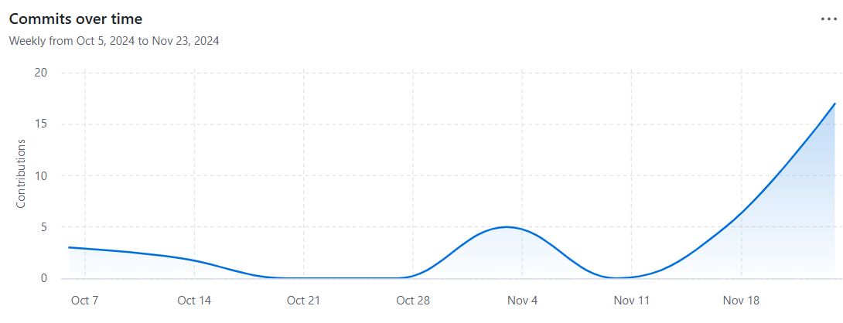
Repo Timeline

